Slide 1
Introduction
Arrays, linked list ,stacks and queues are used to represent the linear and tabular data.
These structure are not suitable for representing hierarchical data.
In hierarchical data we have
  ancestor, descendant
  Superior, subordinate etc.

Slide 2
Family structure
Jaspal
Gurpreet
Navtej
Iqbal
Jaspreet
Noni
Manan
Aman

Slide 3
Business Corporate Structure
President
VP Finance
VP Personal
VP Production
VP Sales
VP Marketing

Slide 4
Federal government Structure
Federal Government
Defence
Telecomm
Finance
Education
Railways
Army
Air Force
Navy

Slide 5
Modular structure of a computer Program
Generating Invoices
Printing Packaging Slips
Accounts receivable
Processing Order

Slide 6
TREE DEFINED
A tree T is a finite non empty set of elements. One of these elements is called the root, and the remaining elements, if any, are portioned into trees, which are called the sub trees of T.

Slide 7
Introduction to Tree
Fundamental data storage structures used in programming.
Combines advantages of an ordered array and a linked list.
Searching as fast as in ordered array.
Insertion and deletion as fast as in linked list.

Slide 8
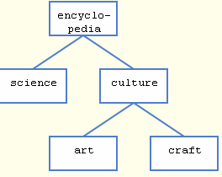
Tree (example)
node
edge

Slide 9
Tree characteristics
Consists of nodes connected by edges.
Nodes often represent entities (complex objects) such as people, car parts etc.
Edges between the nodes represent the way the nodes are related.
Its easy for a program to get from one node to another if there is a line connecting them.
The only way to get from node to node is to follow a path along the edges.

Slide 10
Tree Terminology
Subtree: tree consisting of a node and its descendants
Root: node without parent (A)
Internal node: node with at least one child (A, B, C, F)
External node (a.k.a. leaf ): node without children (E, I, J, K, G, H, D)
Ancestors of a node: parent, grandparent, grand-grandparent, etc.
Depth of a node: number of ancestors
Height of a tree: maximum depth of any node (3)
Descendant of a node: child, grandchild, grand-grandchild, etc.
Degree of an element: no. of children it has
A
subtree
B
C
D
E
F
G
H
I
J
K

Slide 11
Tree Terminology
Path: Traversal from node to node along the edges results in a sequence called path.
Root: Node at the top of the tree.
Parent: Any node, except root has exactly one edge running upward to another node. The node above it is called parent.
Child: Any node may have one or more lines running downward to other nodes. Nodes below are children.
Leaf: A node that has no children.
Subtree: Any node can be considered to be the root of a subtree, which consists of its children and its children’s children and so on.

Slide 12
Tree Terminology
Visiting: A node is visited when program control arrives at the node, usually for processing.
Traversing: To traverse a tree means to visit all the nodes in some specified order.
Levels: The level of a particular node refers to how many generations the node is from the root. Root is assumed to be level 0.
Keys: Key value is used to search for the item or perform other operations on it.

Slide 13
BST
50
25
80
20
40
60
85
10
30
45
65
Since node->right=node->left=NULL, delete the node and place NULL in the parent node

Slide 14

ABES INSTITUTE OF TECHNOLOGY, GHAZIABAD
DEPARTMENT OF COMPUTER SCIENCE AND ENGINEERING
Data Structure-UNIT-5 (AVL Tree)
BY: AVINASH KUMAR SHARMA
ASSISTANT PROFESSOR, DEPARTMENT OF CSE, ABESIT, GHAZIABAD

Slide 15
AVL TREES
If T is non empty binary tree with T_{L} and T_{R} as its left and right sub tree, then T is an AVL tree if and only if:
|h_{L}-h_{R}|<=1, where h_{L} and h_{R} are the heights of T_{L} and T_{R} respectively.
T_{L} and T_{R} are AVL trees

Slide 16
AVL TREES
+1
70
0
70
0
60
-1
80
+1
60
80
0
0
62
0
75
0
92
0
30
Fig (a)
Fig (b)

Slide 17
Representation of AVL trees
The node of the AVL tree is additional field bf (balanced factor) in addition to the structure to the node in binary search tree.
typedef struct nodetype
{
struct nodetype *left;
int info;
int bf;
struct nodetype *right;
}avlnode;
avlnode *root;

Slide 18
AVL TREES
The value of the field bf will be chosen as:
-1 if h_{L}<h_{R}
bf = 0 if h_{L}=h_{R}
+1 if h_{L}>h_{R}

Slide 19
Operation on AVL TREES(4)
Insertion of a node: The new node is inserted using the usual binary search tree insert procedure i.e. comparing the key of the new node with that in the root, and inserting new node into left or right sub tree as appropriate.
After insertion of new nodes two things can be changed i.e.
  Balanced factor
  height

Slide 20
AVL TREES
0
0
8
8
-1
5
10
-1
-1
5
10
0
7
0
15
0
0
7
0
15
0
9
Original AVL Tree
After inserting value 9
Neither the balance factor nor the height of the AVL tree is affected

Slide 21
AVL TREES
+1
0
8
8
-1
5
10
0
-1
5
10
-1
7
0
7
0
15
0
Original AVL Tree
After inserting value 15
Height remains unchanged but the balance factor of the root gets changed

Slide 22
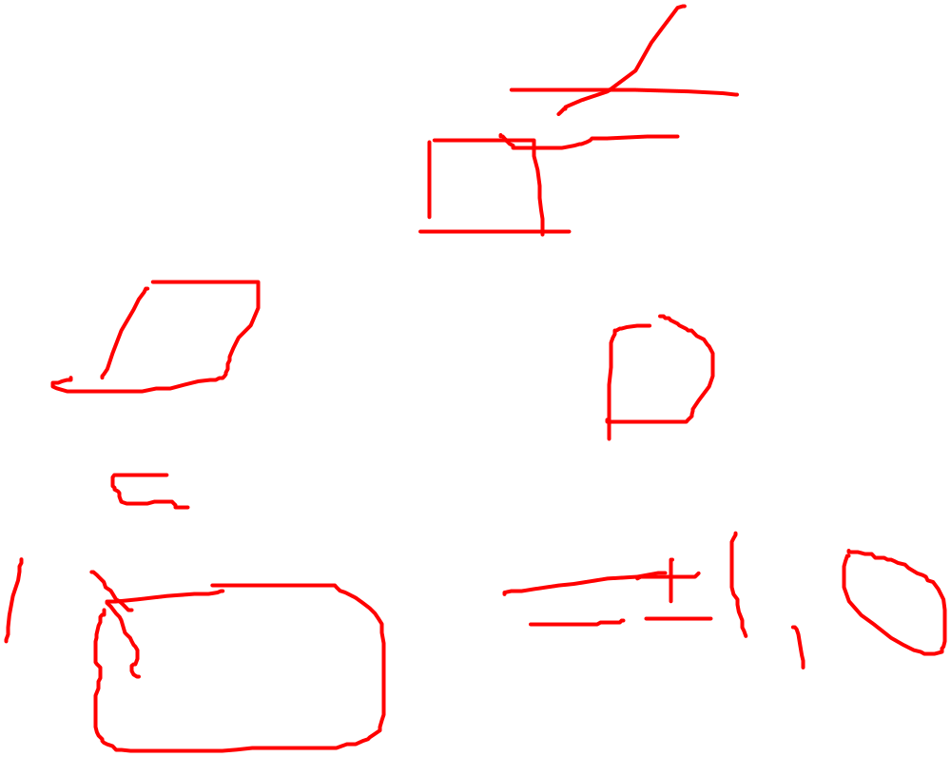
AVL TREES
+2
+1
8
8
-1
0
5
10
0
5
10
0
3
0
7
+1
3
0
0
7
6
0
Original AVL Tree
After inserting value 6
Height as well as balanced factor gets changed. It needs rearranging about root node
In order to restore the balance property, we use the tree rotations

Slide 23

AVL TREES
-2
35
0
0
60
20
60
-1
Rotate left
0
35
65
-1
45
0
65
-1
20
0
45
0
70
0
70
0
Total height 4
Total height 3
Restoring balance by left rotation

Slide 24
AVL TREES
+2
35
0
+1
30
30
50
0
Rotate right
+1
25
35
0
25
+1
33
0
0
0
10
33
50
0
10
0
Total height 4
Total height 3
Restoring balance by right rotation

Slide 25
AVL TREES
+2
+2
35
35
-1
+1
20
50
0
23
50
0
Rotate left
0
0
-1
32
10
23
20
+1
Total height 4
0
10
0
32
0
Rotate right
23
+1
20
35
0
0
0
10
32
50
0
Restoring balance by double rotation

Slide 26
AVL TREES(2)
We can guarantee O(log₂n) performance for each search tree operation by ensuring that the search tree height is always O(log₂n).
Trees with a worst case height of O(log₂n) are called balanced trees.
One of the popular balanced tree is AVL tree, which was introduced by Adelson-Velskii and Landis.

Slide 27
Thank you

